Slide 1
What to do when the results come out
May 2023

Slide 2
Applying to uni? Confirm your choices
You must make your application for student finance immediately. You can do this before you have confirmed your offers and change it later.
You must make your final firm and insurance choices by Thursday 8 June. Make sure your insurance is lower or more flexible than your firm.
Come to PG for help if you are eligible for Clearing Extra

Slide 3
Results day (aka Confirmation and Clearing)
Thursday 17 August 2023
Be at home!
Look at Exams > Exam Results on your database page

Slide 4
Are you off to uni?
Log in to UCAS Track.
If you meet or exceed the grades for your CF offer it will now say Unconditional.
You may still get an offer from your firm choice, even if you have missed your grades. If it says Unconditional they will still take you.
If you meet or exceed the grades for your CI offer but not your CF offer your CI (insurance) offer will say Unconditional.
Congratulations – you are off to uni!

Slide 5
Missed your uni place?
Clearing is a system that matches applicants who don’t have any offers to courses that still have spaces
Clearing Plus on the UCAS Hub matches your application to the best available places left
You can ‘apply up’ through Clearing as well, to better unis if your grades are much better than expected (‘Adjustment’ as it was known has ceased)

Slide 6
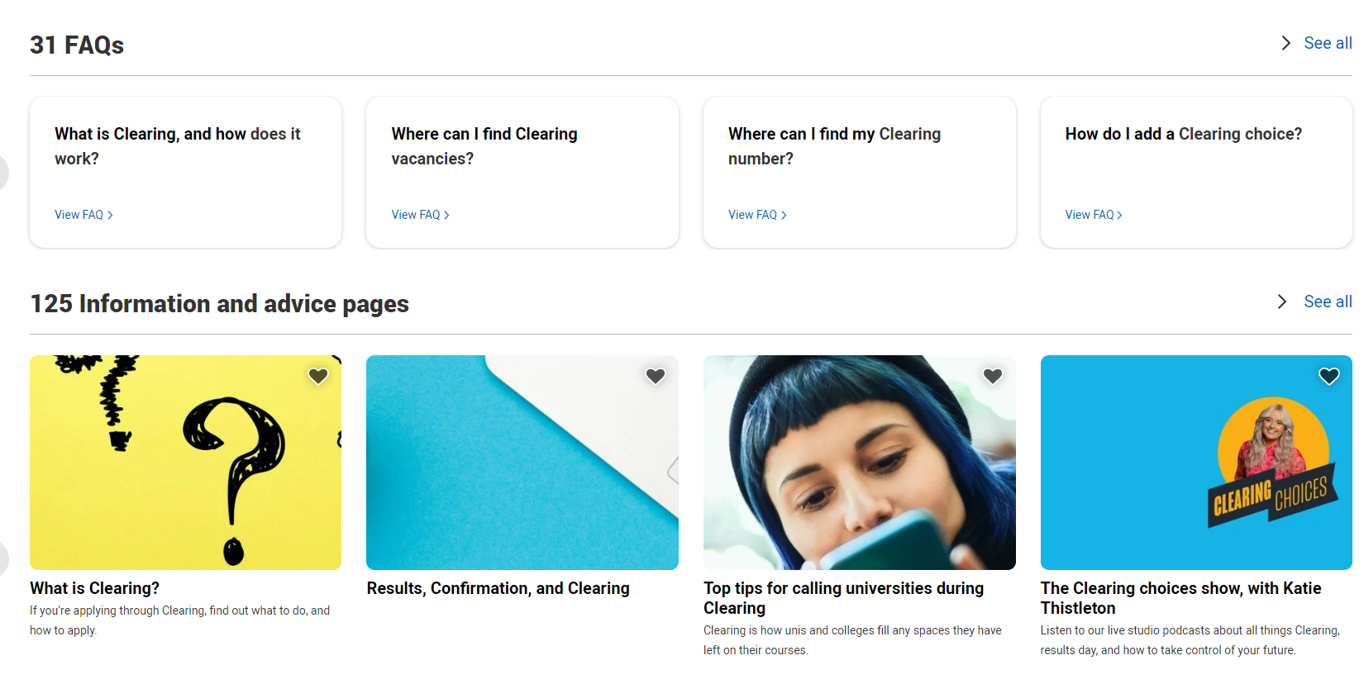
Clearing video
This is a useful short video on Clearing here: How to prepare for clearing – YouTube
Search Clearing in the UCAS Hub and you’ll find lots more information.

Slide 7
Want to go to uni after all?
If you haven’t applied but wish you had, you can apply through UCAS Direct to Clearing from 1 July, but its more sensible to wait ‘til you have your results
The unis have a pretty good idea in advance which courses have under-recruited, so the Clearing lists are first published on 5 July.
If you have offers but are not sure, you can do some research before results day if you want to look elsewhere.

Slide 8
Self-release to Clearing to change or ‘trade up’
You cannot enter Clearing if you have the grades for your CF or CI offer, unless you decide to release yourself into clearing by declining your now confirmed unconditional offer.
Do not release yourself until you have a definite offer from another uni, either by email or from a named person on the phone.
In 2022, 17% of all candidates found a place through Clearing

Slide 9
Come in to College for help
If you have just missed your offer or want help with Clearing or Clearing Plus
Clearing can be stressful – keep calm and don’t panic
Most uni clearing places will been filled quite quickly
Visit the uni in real life if possible or virtually if not
College staff are available to help on the Thursday from 8.30am and Friday from 9am

Slide 10
Applying for an apprenticeship or job?
Use Unifrog to search, identify your competencies and prepare your CV.
Your Unifrog account last for 3 years after you leave ESFC. Change your primary email from your college to a personal one.
Apprenticeships info is updated daily so keep looking
If you need help applying for apprenticeships, please contact the Progression Guidance office progression@esher.ac.uk
If you need a reference for a job, ask your tutor nicely by email first, before putting their name as a referee.

Slide 11
Post-results UCAS application
If you want to apply to uni through UCAS apply 2023 with your results we refer to you as a ‘6.3’ or post – results applicant
You still apply through Esher Sixth Form College, we write your reference and we still help you
There will be a 6.3 applicants' session on Teams early in September (exact time tbc)
Start research for entry in 2024 now, and go to Open Days this summer if they are happening

Slide 12
Post-results UCAS application
Tell your tutor now if you think you are going to apply post-results
They will still be the person who writes your reference
Your reference will be based on your subject teachers’ end of year 1 summary reports, with updates if required
The same deadlines will apply – but the earlier your application the better

Slide 13
Esher College UCAS 2024 deadlines
All deadlines are by 8 am on the following Mondays:
Oxbridge, medics, vets and dentists: Wednesday 27 September
‘Competitive applications’– your reference gets dealt with in 10 working days: Monday 9 October
General deadline - your form gets to UCAS before Christmas: Monday 6 November
Final deadline - your form gets to UCAS by 25 January 2023: Monday 20 November

Slide 14
Keep us updated
Keep us updated about what you are doing through the database > destinations tool when still here, and when we email you once you leave
Follow Esher Sixth Form College on
Unifrog lasts for 3 years after you leave
Your connection with Esher Sixth Form College lasts forever!
Good bye, good luck and keep in touch

